Slide 1
TERRAFORM WITH RDS

Slide 2
Definition :
RDS:Amazon Relational Database Service (RDS) is a web service that helps users set up, operate, and scale relational databases in the cloud.

Slide 3
Basic Steps for Setting Up RDS with Terraform
Install Terraform:
First, you need to install Terraform on your machine. You can download it from the official website: Terraform Downloads.
Configure AWS Provider:
Set up the AWS provider in Terraform to authenticate and allow interaction with your AWS account.
Define an RDS Instance:
Write a Terraform script to define the RDS instance resource.

Slide 4
Terraform Configuration for an RDS Instance
provider "aws" {
region = "us-east-1"
}
resource "aws_db_instance" "myinstance12" {
engine = "mysql"
identifier = "myrdsinstance"
allocated_storage = 20
#db_name = mydb
engine_version = "8.0.39"
instance_class = "db.t3.micro"
username = "myrdsuser"
password = "myrdspassword"
parameter_group_name = "default.mysql8.0"
skip_final_snapshot = true
publicly_accessible = true
}

Slide 5
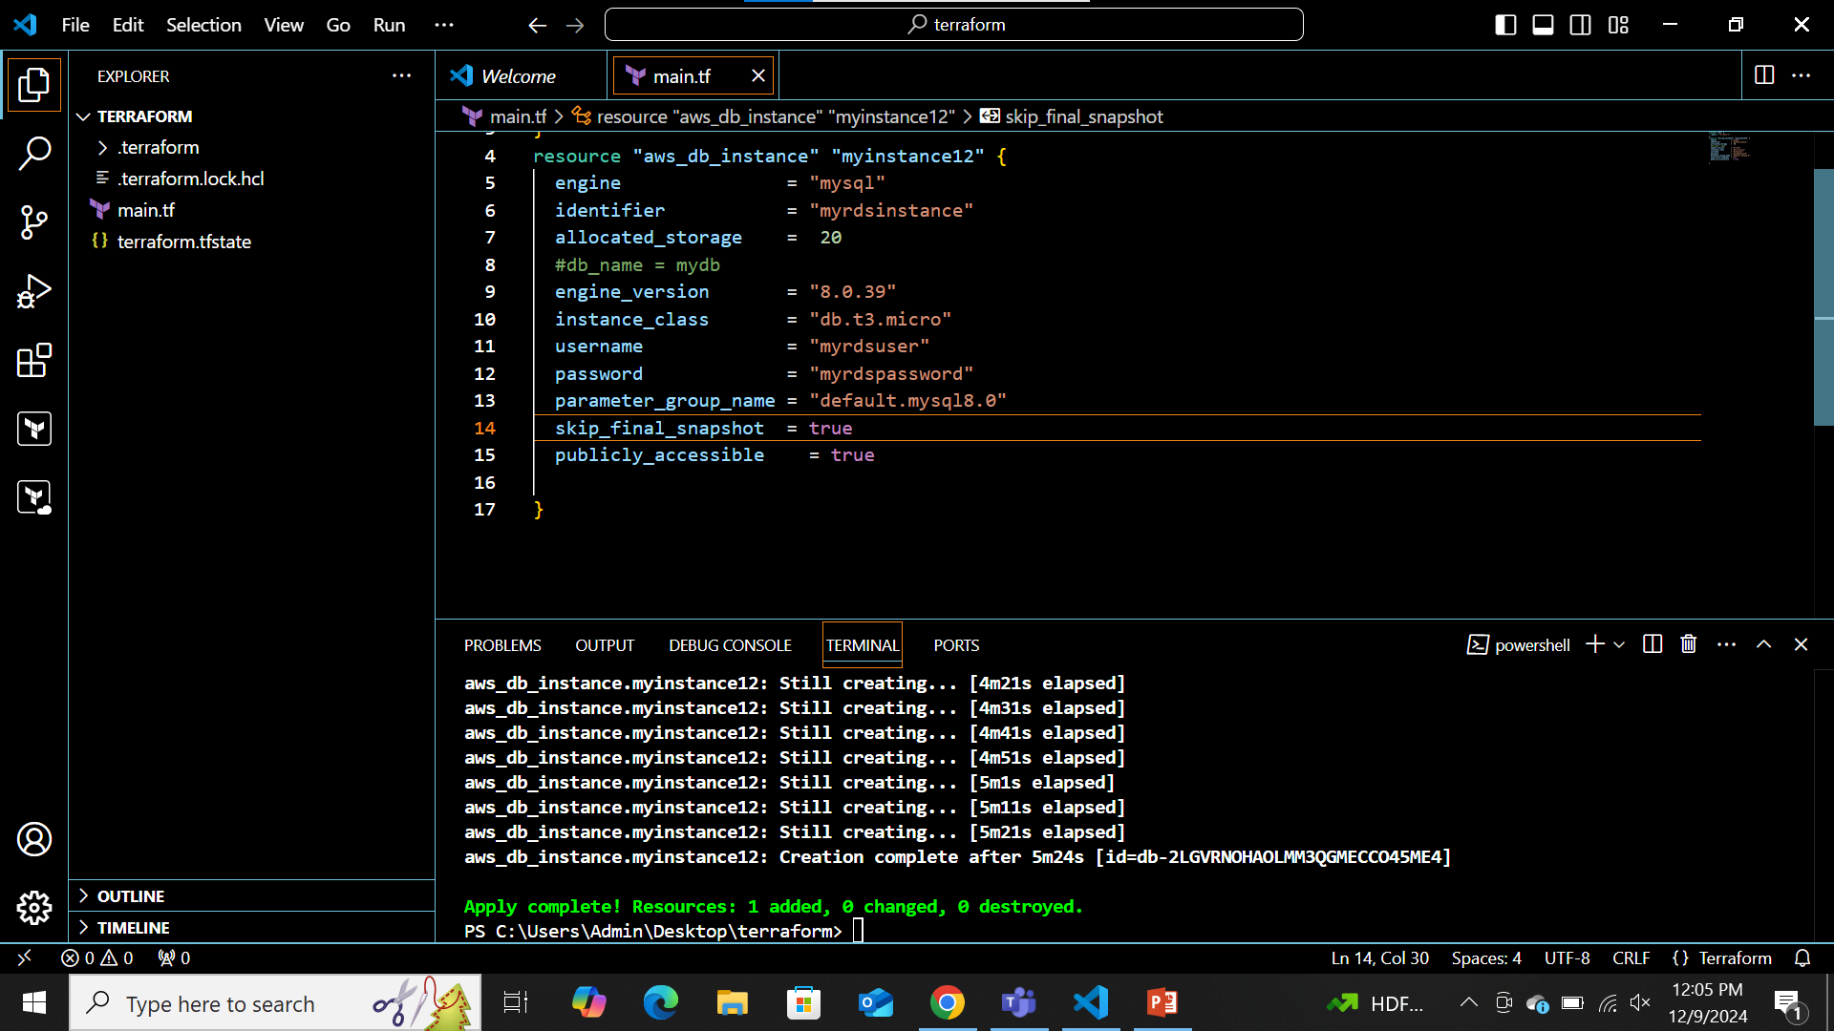

Slide 6
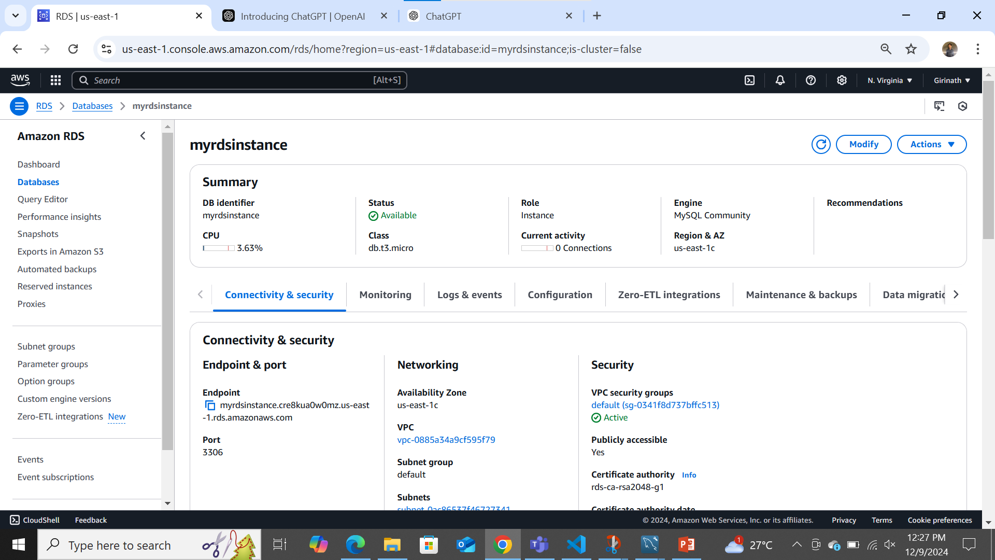

Slide 7

Create database and attach to the mysqlworkbench

Slide 8
THEN WE HAVE TO OPEN THE MYSQL WORKBENCH.
AND CHANGE THE ROOT PASSWORD&USER.

Slide 9
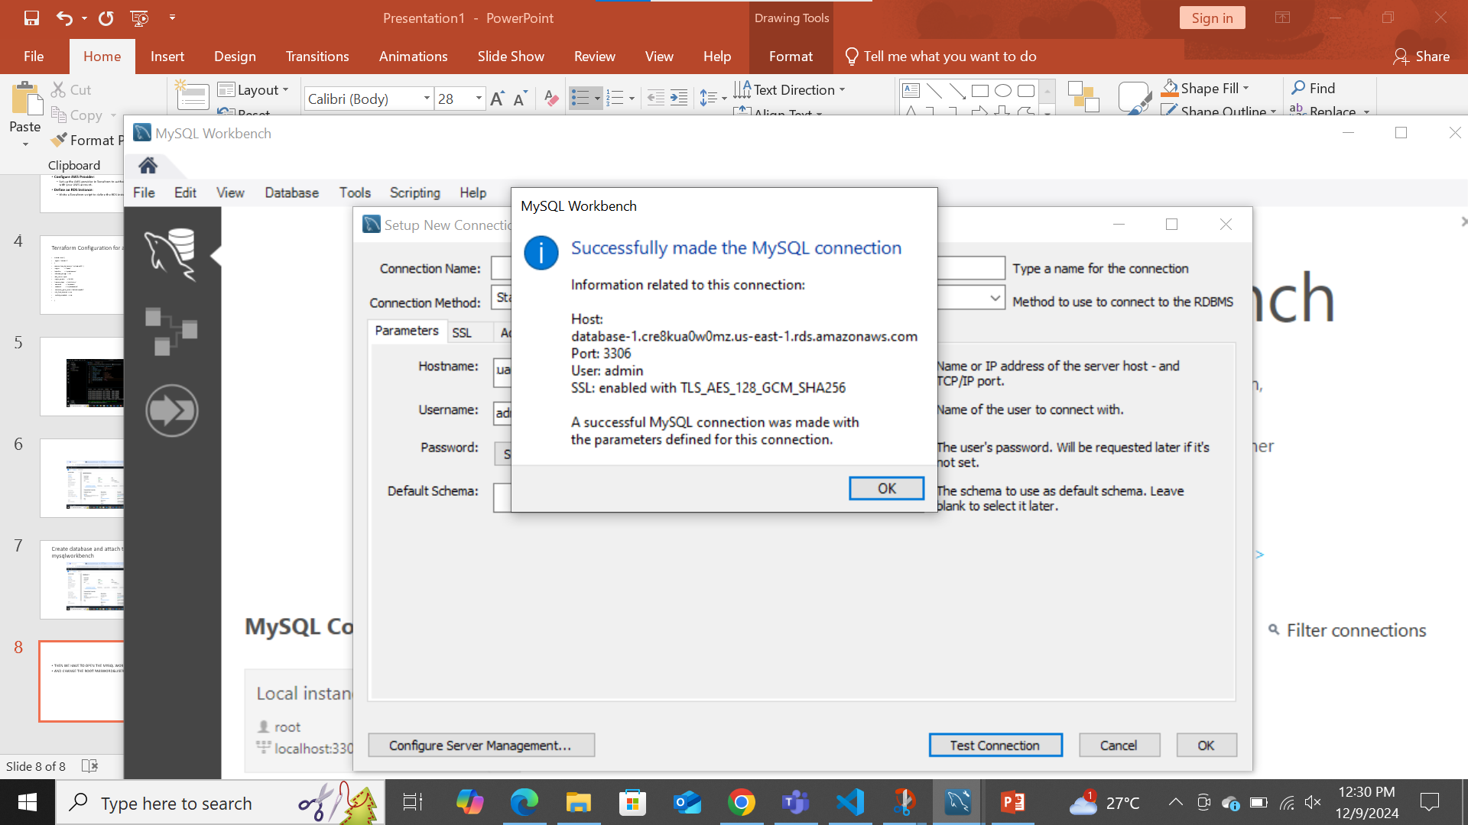

Slide 10
THANK YOU

